Slide 1
OPERATOR OVERLOADING IN C++
In C++, we can make operators to work for user defined classes.
This means C++ has the ability to provide the operators with a special meaning for a data type, this ability is known as operator overloading.

Slide 2
NON-OVERLOADABLE OPERATORS
(::) SCOPE RESOLUTION OPERATOR
(.*) MEMBER SELECTION TO POINTER THROUGH FUNCTION
(.) MEMBER SELECTION
(sizeof) SIZEOF OPERATOR
?: TERNARY OPERATOR

Slide 3
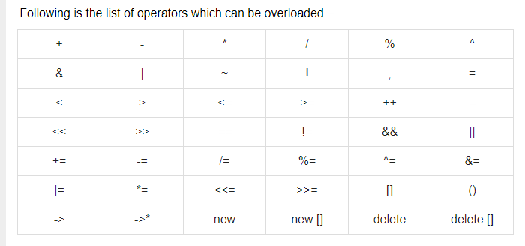
OVERLOADABLE OPERATORS

Slide 4
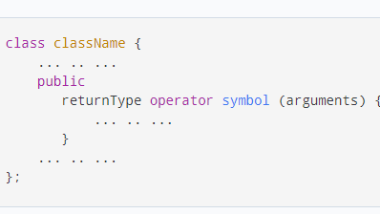
SYNTAX
To overload an operator, we use a special operator function

Slide 5
RULES FOR OVERLOADING OPERATOR
ONLY EXISTING OPERATORS CAN BE OVERLOADED.
NEW OPERATORS CANNOT BE CREATED.
THE OVERLOAD OPERATOR MUST HAVE AT LEAST ONE OPERAND THAT IS OF USER-DEFINED TYPE.
WE CANNOT CHANGE THE BASIC MEANING OF AN OPERATOR.

Slide 6
BINARY OPERATORS
The binary operators take two arguments and following are the examples of Binary operators.
In binary operator overloading function, there should be one argument to be passed.
You use binary operators very frequently like addition (+) operator, subtraction (-) operator and division (/) operator.

Slide 7
UNARY OPERATORS
The unary operators operate on a single operand and following are the examples of Unary operators .
The increment (++) and decrement (--) operators.

Slide 8
RELATIONAL OPERATORS
Relational operator overloading is frequently used to compare many of the built in data types in C++.
We can overload relational operators like >,<,>=etc to directly manipulate the object of the class.

Slide 9
ASSIGNMENT OPERATORS
You can overload the assignment operator (=) just as you can other operators and it can be used to create an object just like the copy constructor.

Slide 10
FRIEND FUNCTION
If a function is defined as a friend function in C++, then the protected and private data of a class can be accessed using the function.
By using the keyword friend compiler knows the given function is a friend function.
For accessing the data, the declaration of a friend function should be done inside the body of a class starting with the keyword friend.

Slide 11
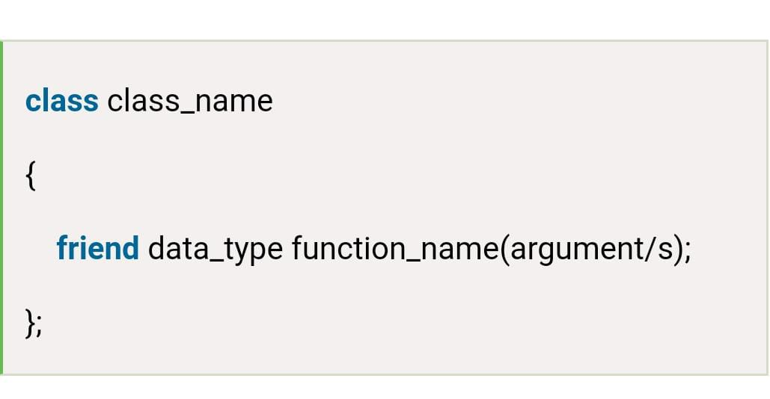
SYNTAX FOR FRIEND FUNCTION

Slide 12
CHARACTERISTIC OF FRIEND FUNCTION
It cannot be called using the object as it is not in the scope of that class.
It can be invoked like a normal function without using the object.
It cannot access the member names directly and has to use an object name and dot membership operator with the member name.
It can be declared either in the private or the public part.

